Slide 1
Welcome to Microsoft Azure for Research Training!
Microsoft Research
Windows Azure for Research Training
Notes:
The trainer needs to give 15-20 mins at the start of the course with this material to ensure *everyone* is online and shows the Microsoft Azure Dashboard before continuing onto the overview.

Slide 2



Microsoft Azure for Research
Accelerate the Speed of Scientific Discovery
Microsoft Azure provides researchers with the power and scalability of cloud computing for collaboration, computation, and data-intensive processing. This open and flexible global cloud platform supports any language, tool, or framework.
The Microsoft Azure for Research program:
· Free access to Microsoft Azure cloud computing and storage
(submit proposals for Microsoft Azure Research Awards)
· Microsoft Azure for Research training classes
· Support and technical resources
Apply the power of cloud computing to your computational and data challenges. Experiment at azure4research.com.
Notes:
What MSR is doing

Slide 3
Microsoft Azure for Research
Learning objectives – what you will learn from the class:
An understanding of cloud computing
Why and when you would use it in scientific or other research
Hands-on experience in major patterns for successful cloud applications
Skills to run your own applications/services on Microsoft Azure
Ultimately: researchers will feel confident in applying cloud computing in their current and future research

Slide 4
Agenda
Presentations, demos, hands-on labs
Day 1
Logging in for the first time – the Training Accounts
Microsoft Azure Overview
Microsoft Azure Websites, Virtual Machines, Storage and Cloud Services
Day 2
Recap for Day 1
High performance computing on Windows and Linux
Big data tools and visualization
Streaming data from instruments and mobility
Wrap-up

Slide 5

Trainers
Add trainer introduction here!

Slide 6
Azure Training Pass
Free Azure Pass http://azure.microsoft.com/en-us/pricing/free-trial/
- $200, 30 day pass
To activate
phone number
a credit card (does not get charged for $200 credit)
- Microsoft Account username (formerly Windows Live ID).

Slide 7
Microsoft Azure Training Accounts
MSRAzureTrain<your_number>@outlook.com
Example, for attendee number “3”: MSRAzureTrain3@outlook.com
Sign in at: https://manage.windowsazure.com/
Your individual password and personal training number have been shared with you directly – they are valuable! Keep them safe.
You will have 4 cores, 2 storage account for 6 months trail for FREE!
Notes:
FAQ if asked:
1. What resources does this account give me?
4 cores (2x student accounts)
2 storage (2x student accounts)
20 services (1x student accounts)
180 days (1x student accounts)
Retail value is approx. US1200-2400 if maximally used.
2. How long does this training account last?
180 days (~6 months)
3. What happens when the time is expired?
You’ll get a reminder or two near the end of the time to upgrade to a paid account – about a week’s notice. Then the account will be closed if you do not convert to a paid account at that time. You will need to transfer your data/VMs to your new account. There are how-to guides on this.
4. Do I have to pay after the time is expired?
Yes, though there are some other options. As an academic, typically you would seek Microsoft Azure support from your IT department (who would pay for the service from their budget), or your project funds would pay. Also, you could make sure to apply for one of MSR’s Research Awards, which comes with ~12 months at no cost and much larger amounts of compute/storage resources than the training pass.
5. Can I get more time for evaluation?
Sorry, the Training Passes cannot be extended. See the previous question for some options.
<end>

Slide 8
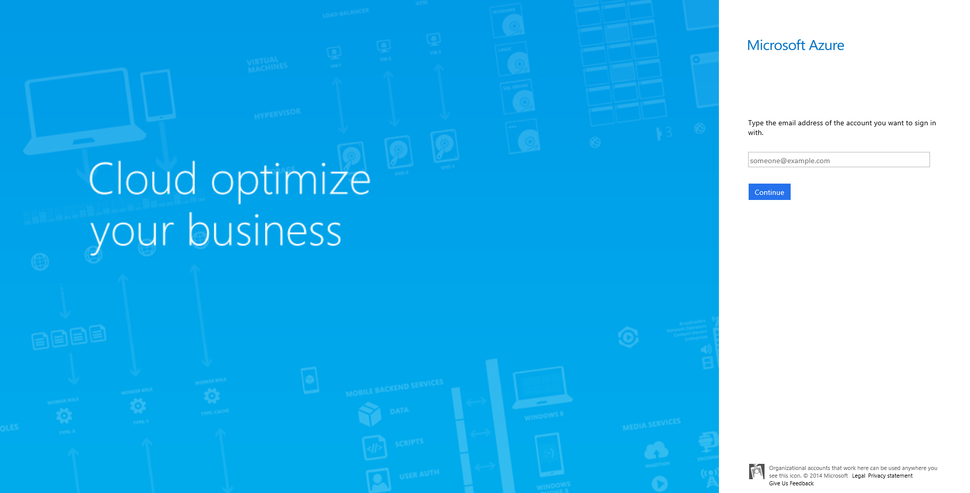
Notes:
This is what you will see if you haven’t got an MS account before, or have a completely fresh browser.
Hit “Keep Me Signed In” to make things easier during the training – preserves session information.

Slide 9
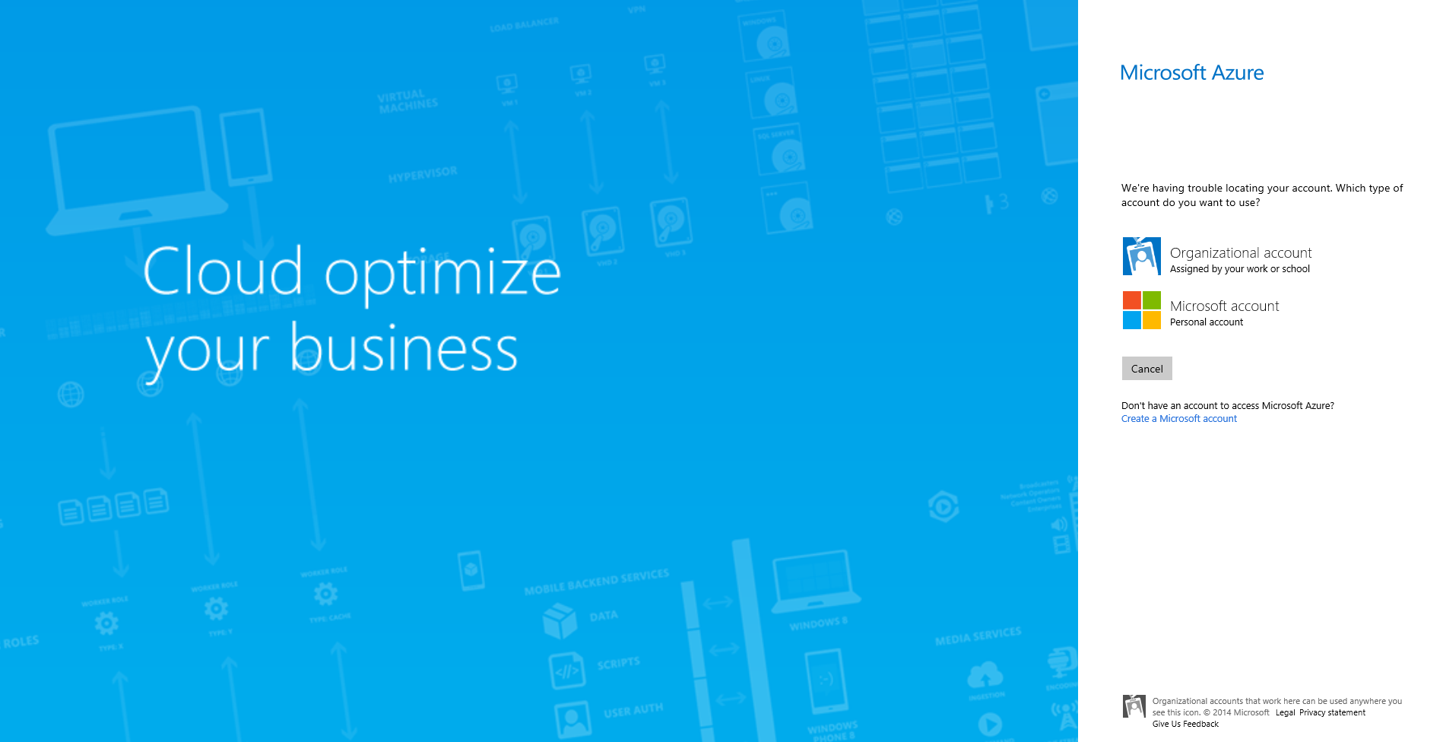
Notes:
If you are already logged in to another MS account, your current account email address will be shown – hit “Sign in with a different Microsoft account” to get out of this.
You sometimes get an error when doing this – no worries. See next page.

Slide 10
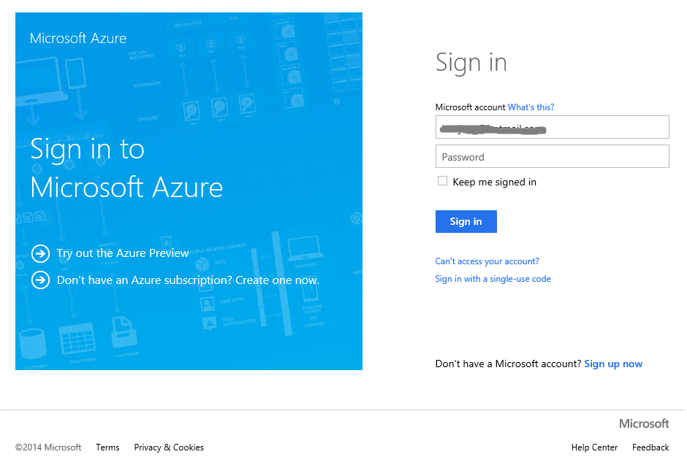

Slide 11
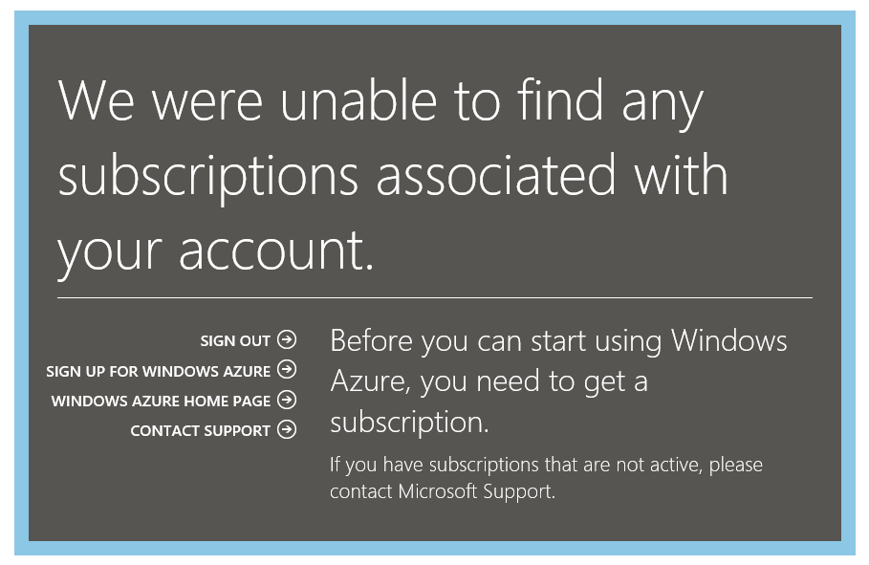
Notes:
Most people won’t see this – but if you have previously evaluated Microsoft Azure and are logged into an MS account in another browser window, you may see this – to get out of it, hit “sign out”.
Ignore any error you get on the Sign-Out page (annoying, but ignorable).
Now try https://manage.windowsazure.com/ again.

Slide 12
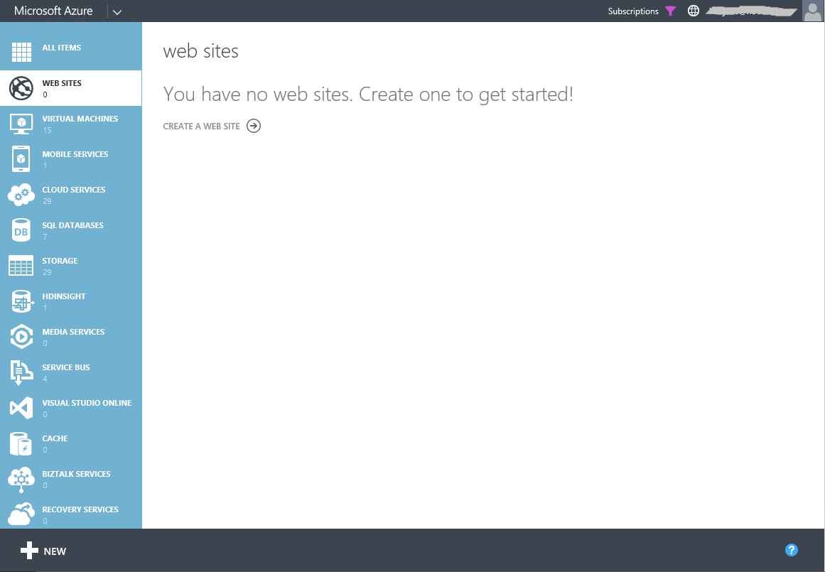
Notes:
What you should get to – the Microsoft Azure Dashboard – now we are ready to go!
(Fresh accounts will see no services running – in the screenshot, a website and other services are running from a previous session – ignore.)
Optional: the trainer may want to start up some key items at this point:
Get access to the course default VM.
Download all the course materials locally to people’s client machines (watch out for the load on the network in doing it – may be better to stagger this).

Slide 13
Questions?
Notes:
At the UW class we had an unusual situation where Microsoft Azure instigated two-factor authorization on the very morning we ran the class. This meant that some people ran into a series of dialogs during first log-in to confirm ownership of the Training Account using a second ID factor (the first ID factor is the password we give to each student individually). The second factor was either an email or a SMS message to a phone. This was quite inconvenient! But if you just step through the dialogs, it worked ok.
The trainer needs to give 15-20 mins at the start of the course with this material to ensure *everyone* is online and shows the Microsoft Azure Dashboard before continuing onto the overview.
Note: most decks in the course do not have a “Questions” slide at the end because it is expected that the trainer will do this naturally and frequently. We actively want to discourage “present for 30 mins then ask questions at the end”, which is not a good learning style anyway. We selectively use this Questions slide at limited points in key parts of the course where it is imperative to pause.

